Slide 1
Testing and Debugging
Advanced Software Engineering – October 2019
Thalita Vergilio

Slide 2



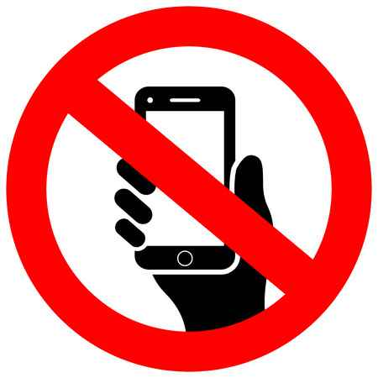



Ground Rules
You have the option to sit out and do your own thing.
You are expected to participate.
No e-mails, social media, etc, unless it is related to the session.
You can ask questions any time you like.
We will have phone breaks every 30min.

Slide 3



Quiz time!
1
Just for a bit of fun, we are going to play a quiz game throughout this lecture.
You will need:
Notes:
Get students in pairs. Show Kahoot page and play group game (best to use a PC, as some phones disconnect). Make sure everyone is in.

Slide 4
Software Bugs

Slide 5
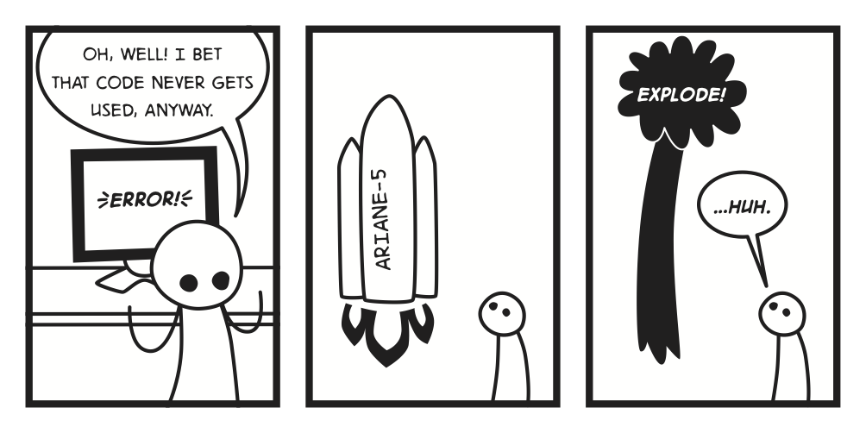
Defects are expensive…
Bugs cost an estimated $1.1 trillion in the US alone.
The cost of a bug found in post-production release is 30 times more expensive than if it was found during the design phase.
Notes:
Question 1

Slide 6

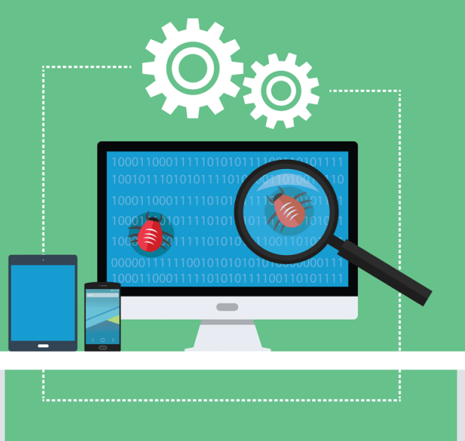
What is the difference between testing and debugging?
≠
Testing is trying to demonstrate that your program is free of defects.
Debugging is finding and fixing defects.
It is a continuous process.
It is an ad-hoc process.
Notes:
Question 2

Slide 7
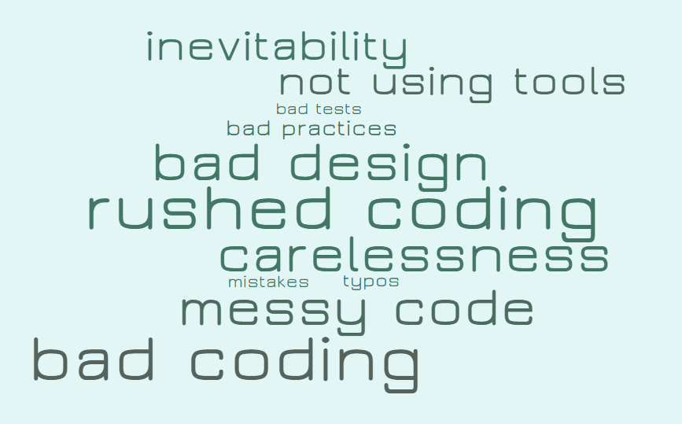

Why do bugs occur?

Slide 8


Bug Prevention
Use appropriate style.
There’s an amount of embarrassment in someone else finding your deficiencies!
Use appropriate techniques.
Use defensive programming.
Change little, test often.
Notes:
Elicit coding conventions, style checker, best practices, design patterns, defensive programming.

Slide 9
Why use a debugger?
Watch the behaviour of your code step by step.
Stop the execution at breakpoints.
Evaluate the value of your variables at runtime.
Change the value of variables and continue.
Evaluate ad-hoc expressions at runtime.
Notes:
Questions 3-8.

Slide 10
Software Testing

Slide 11
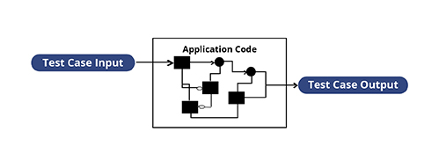
Black Box vs. White Box Testing
≠
Notes:
What is the difference between white box testing and black box testing? Which are you more likely to perform as a developer? Example.
Which is more important? They are both important.

Slide 12
Unit Tests
Are run programmatically.
The developer records inputs and expected outputs.
A test class for each class in your program.
One or more test methods for each method in your class.
Try to cover every possible scenario:
Nulls
Zeros/Empty Strings
Messed-up Data
Happy Path
Notes:
Question 9

Slide 13
Integration Tests
Are run programmatically, after unit tests.
Tests that components developed independently work together.
Uses mocks and stubs to represent external collaborators.
Notes:
Elicit examples. Why do you need to mock? Example of SMTP server for e-mail service.

Slide 14
Functional Tests
Test that the functional requirements were implemented correctly.
Based on scenarios and test cases.
Can be run programmatically by using frameworks such as Selenium, Geb, Cucumber, and others.
Black box tests.
Notes:
Elicit: are they white or black box tests? Who defines the functional requirements?

Slide 15
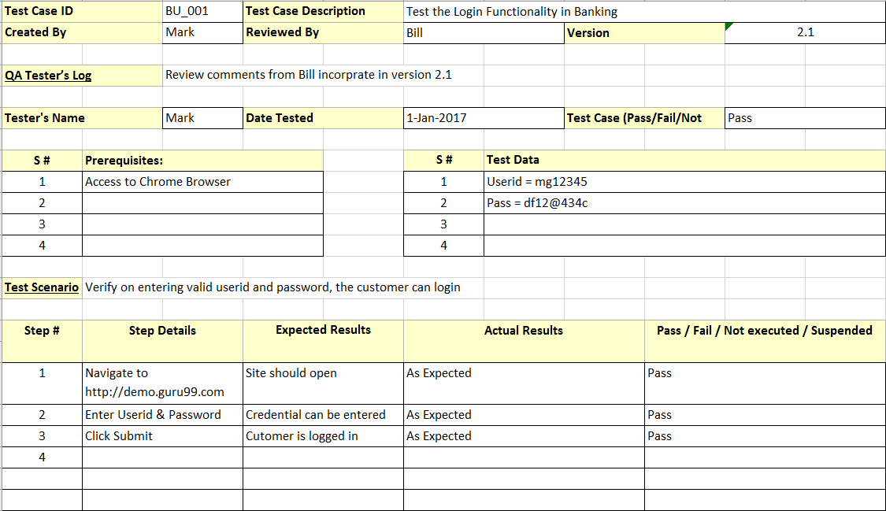
Test Case
Notes:
Question 10

Slide 16
Penetration Tests
Test the security of a system.
Five phases:
Aim is to identify vulnerabilities at different levels:
Network
Operating System
Application Server
Application
Reconnaissance
Scanning and Enumeration
Gaining Access
Maintaining Access
Covering Tracks
Not an automated test and not usually a developer’s job.
Notes:
Elicit what they are and how these are different from the previous tests.

Slide 17
Advantages of Automated Tests
Can/Should be run as part of every build.
Document the intended functionality of your methods.
Allows you to refactor your code (as long as it passes the tests, all is good).
If you write something that breaks existing code, the tests will fail.
They are cheap and easy to run.
They make you comply with best practices by forcing you to write “testable code”.

Slide 18
Disadvantages of Automated Tests
It takes time to write them.
They can be more complex than the implementation code.
Another set of libraries to familiarise yourself with.
Each method needs several tests.
However…
They will save you time in the long run.
They are incremental: as you discover more defects, you add more tests to show that your software is protected against them.

Slide 19

Test-Driven Development
Write Test
Run Test
Write Code
Run Test
Refactor
Run Test
Always start with a test.
Just enough to pass the test…
Tidy up your code!
Aim to pass.
If it doesn’t, go back to the previous step.
Make sure all test are still green.
It will fail!
Notes:
Question 11

Slide 20

Any Questions?
Thank you very much!

Slide 21

Now it’s your turn to work!
The lab exercises are in My Beckett.
The source code for the Bank exercise can be found here:
https://bitbucket.org/vergil01/bank-2-ase/src/master/
The source code for the XUnit.net exercises can be found here:
https://bitbucket.org/vergil01/csharp-xunit-exercises/src/master/
The peer review board for this session can be found here: https://padlet.com/t_vergilio/begjpp2up89j
Duncan recorded a very nice demo of how to use the debugger. It can be found here.
My e-mail address:
t.vergilio@leedsbeckett.ac.uk

